Slide 1
Outline
Bioinformatics philosophy
We will be working in the bash or “command line” environment.
Environmental genomics
We will focus on practice and principles critical to envirnomantsl genomics
How is the data generated?
Critical to know limits and biases
Data “structures”
Bioinformatics requires predictable data formats and conventions

Slide 2
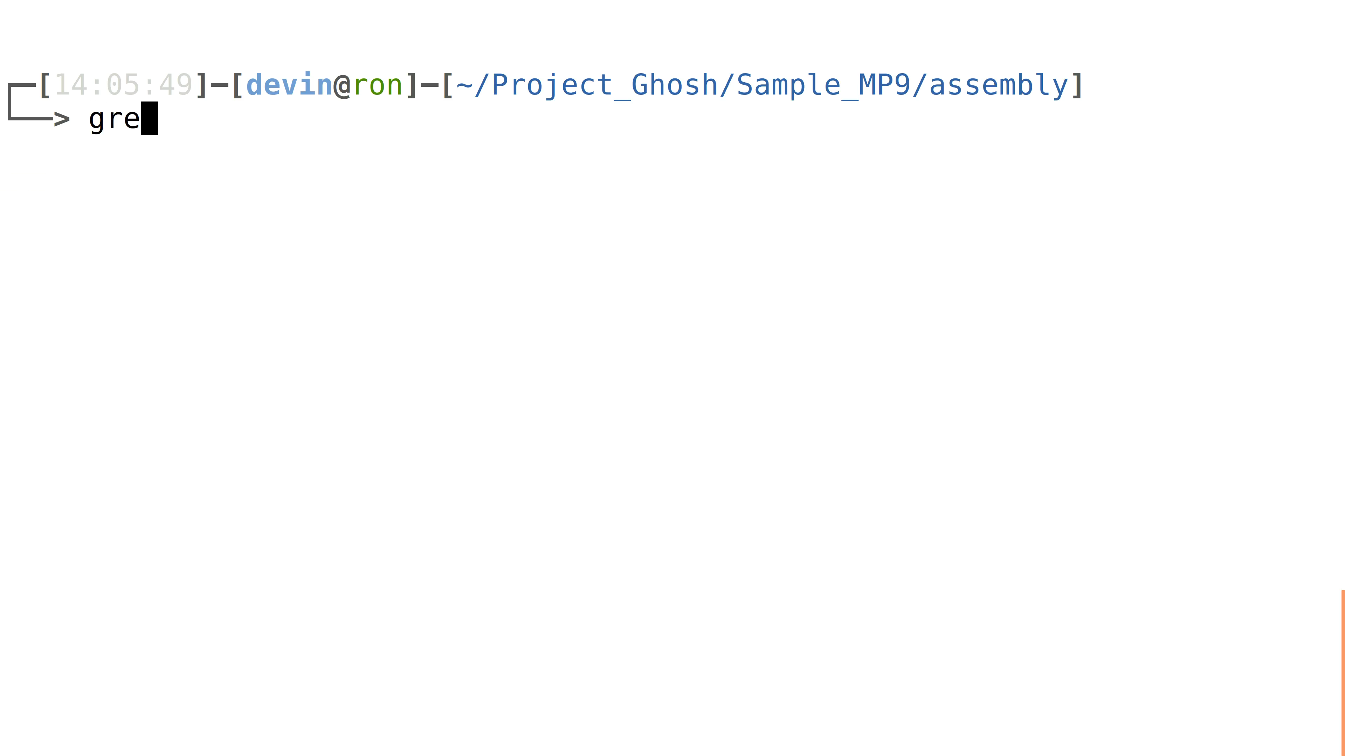
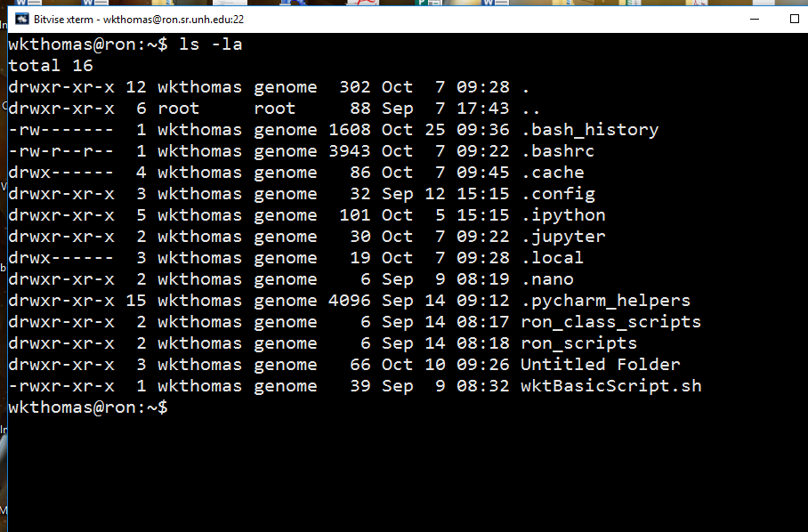
Why are we pushing the Bourne Again SHell (BASH)?
It is how real bioinformatics is done.
Opens door to vast library of software.
This is how people deal with all forms of “Big Data”.
This is stable/durable knowledge.
Unfortunately:
Most faculty are not experts.
Hard to teach what you don’t know.
This is where we provide the focused help.

Slide 3
Concepts for environmental genomics
Metagenomics: The study of genetic information gathered directly from the environment. AKA: environmental genomics, ecogenomics, or community genomics
Sometimes “Whole metagenome shotgun sequencing”
Metabarcoding: uses “Universal” PCR primers to identify DNA from a mixture of organisms AKA: Amplicon or Marker gene sequencing.
eDNA: DNA does not have to come directly from the organism.

Slide 4
Major Metagenomic Workflows
Metabarcoding
Whole Metagenome Shotgun
Environmental Sampling
Environmental Sampling
DNA Extraction
DNA Extraction
Marker Gene Amplification
Whole Metagenome Sequencing
High-Throughput-Sequencing
Metagenome Assembly/Sorting
Mapping Reads to References
Identification of sequence features
Matching to “functional” Database
Matching to Taxonomic Database
Every single step introduces biases

Slide 5
Major Workflows
Metabarcoding
Whole Metagenome Shotgun
Positive Aspects
Efficient
Possible to process 1000 of samples
Negative Aspects
PCR Limitations
Limited by databases
Not directly related to ecosystem function
Positive Aspects
Produces “functional” and taxonomic data
Not restricted by PCR All “organisms”
Negative Aspects
Inefficient
Limited by databases

Slide 6
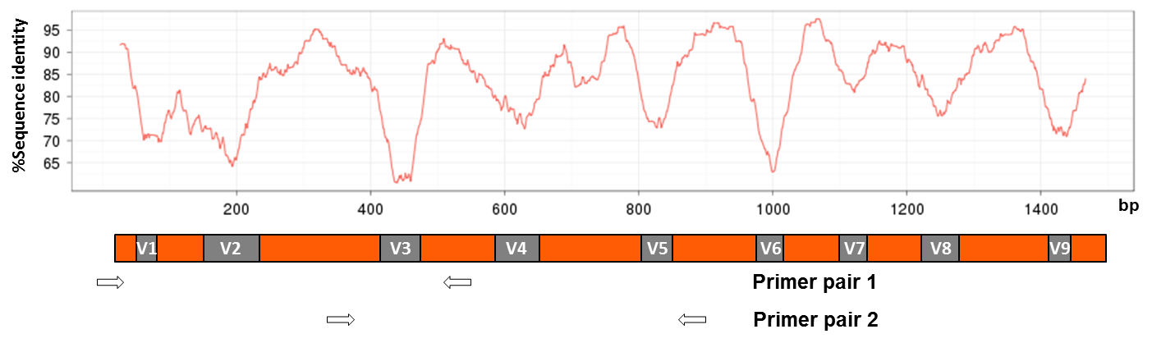
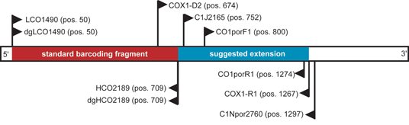
Marker Genes/Barcodes
Ribosomal RNA
Mitochondrial DNA

Slide 7
The generation of Genomic Data
Next Generation DNA sequencing technologies

Slide 8
A sea-change in genome-enabled biology
The last several years have seen the development of fundamentally new sequencing technologies.
A process that continues…
These technologies produce more data, and better data in many fewer steps.
These changes make genomic analysis a core approach in diverse areas of biology

Slide 9
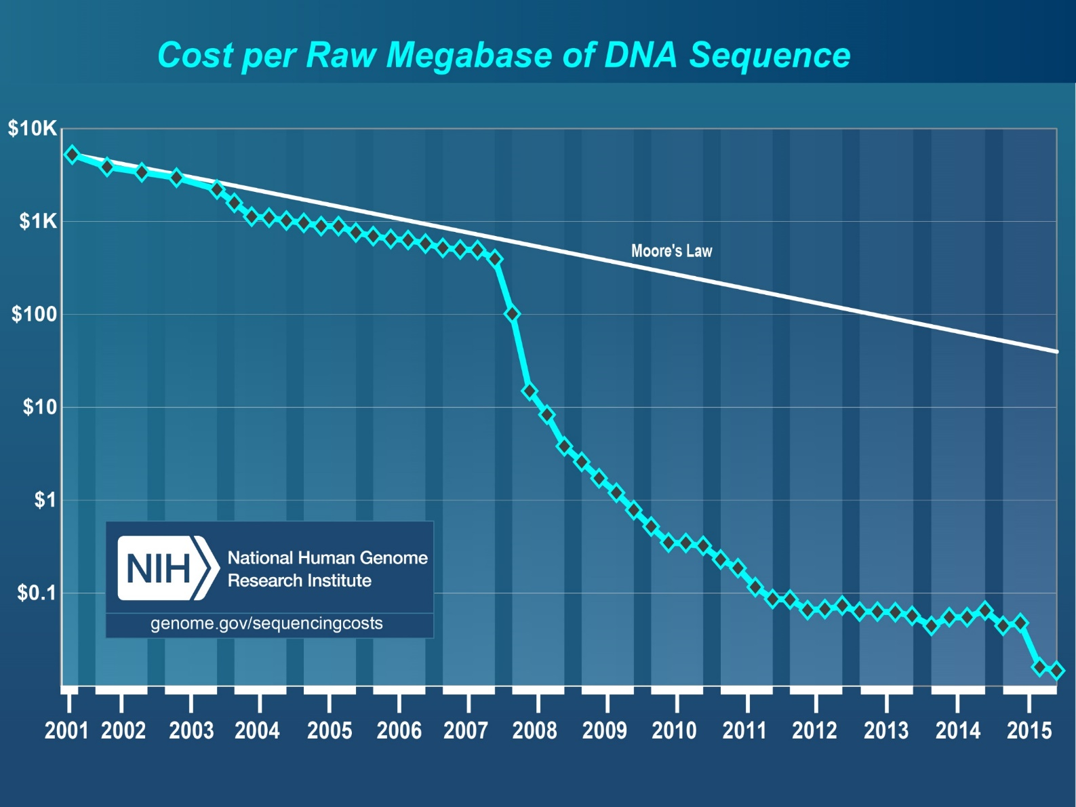
“Sequencing is now the cheapest part of sequencing” C. Titus Brown
Notes:
Faster than Moore;s Law
Implication to the IT community

Slide 10
Cost of Meta-barcoding
Sampling $10 -$10,000 per sample
DNA Isolation – $5-$10
PCR $1-$5
Sequencing $ 1 for 50,000 reads
Analysis: $150/hour
Your experimental design should keep
these relative costs in mind

Slide 11
Next Generation Sequencing Technologies
The dominant sequencing approach today is Sequencing by Synthesis (SBS) from Illumina. This technology produces the vast majorities of datasets and will be the method used for your sequencing.
Other interesting and useful approaches include the Single Molecule Real Time (SMRT) Sequencing approach by Pacific Biosciences and Nanopore Sequencing by Oxford Nanopore Technologies. Both of these technologies can produce much longer “reads” or continuous runs of sequence information.

Slide 12
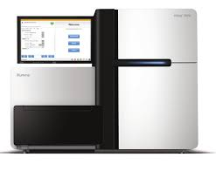
Illumina Sequencing by synthesis
Watch a Video showing the basics of the technology
Serious
https://www.youtube.com/watch?v=womKfikWlxM
Not so serious
https://www.youtube.com/watch?v=-7GK1HXwCtE

Slide 13
Basic Process

Slide 14
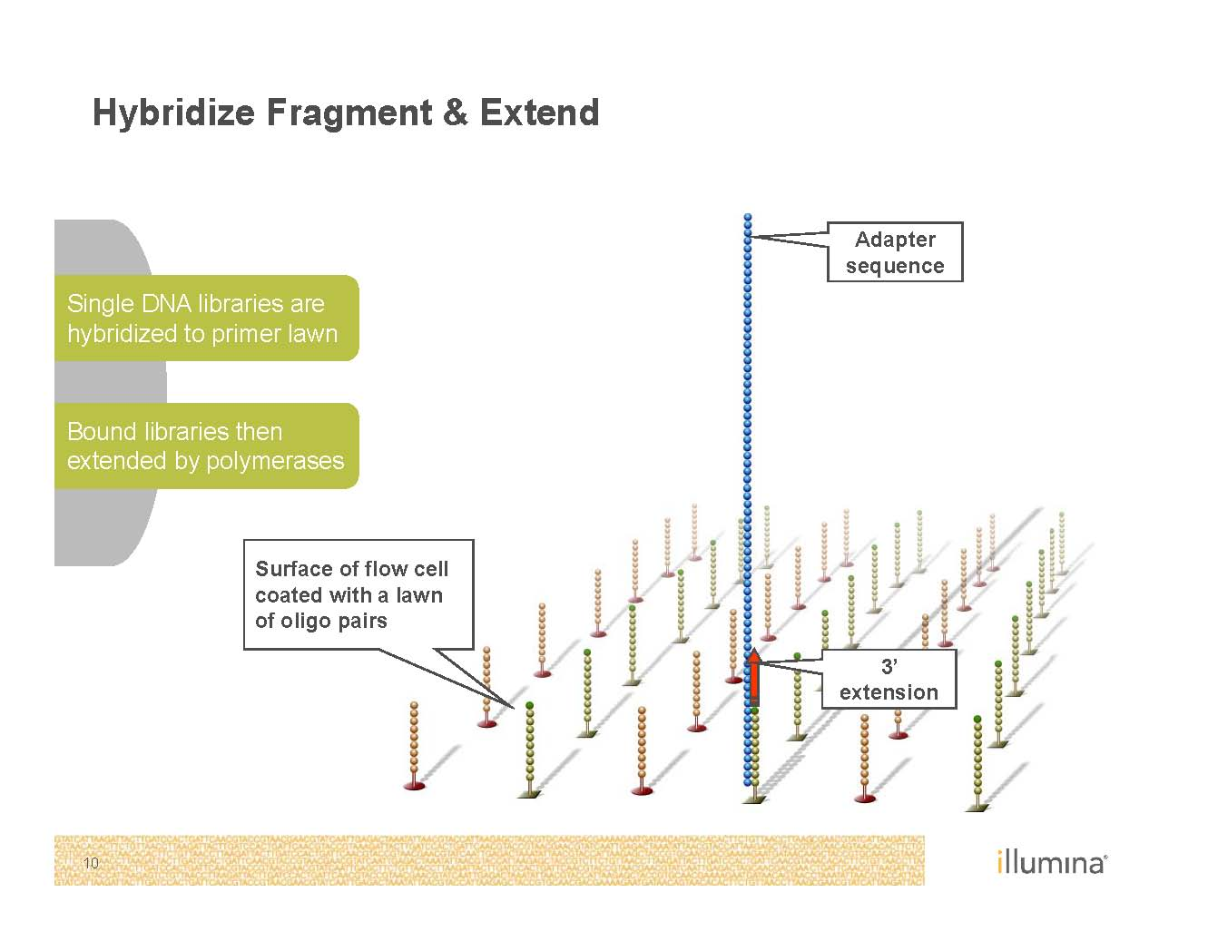
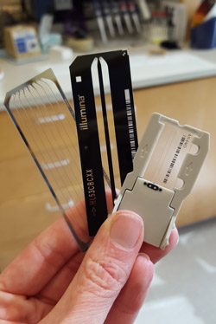
Sequencing on the inside surface of a flowcell

Slide 15
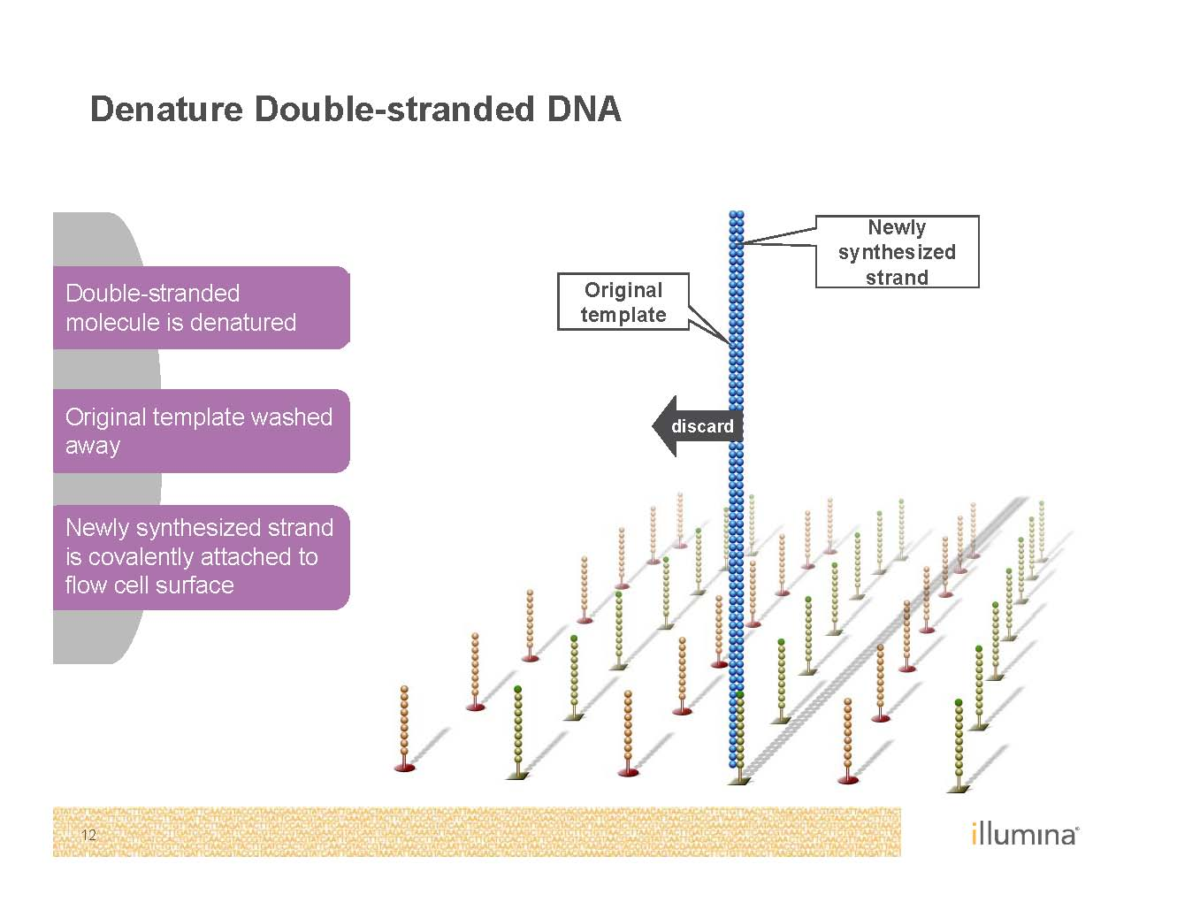

Slide 16
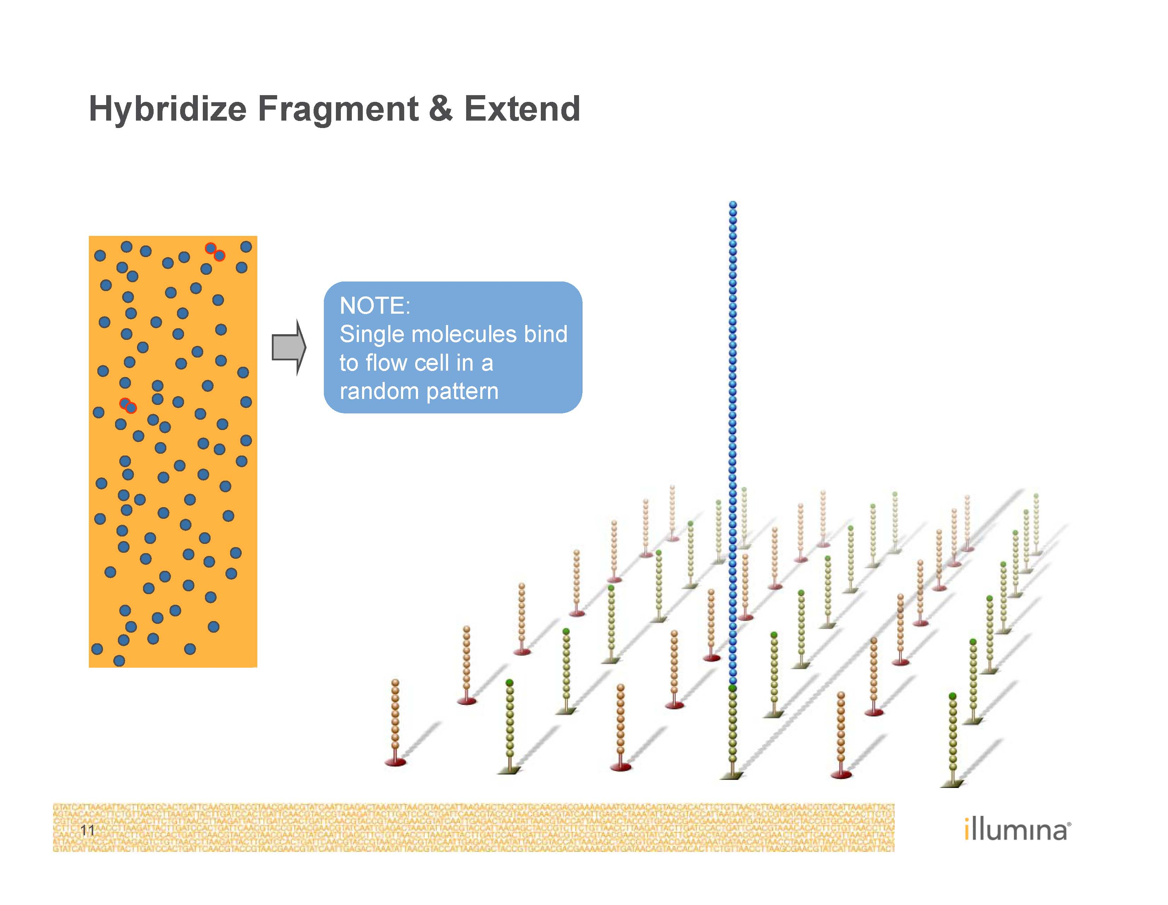

Slide 17
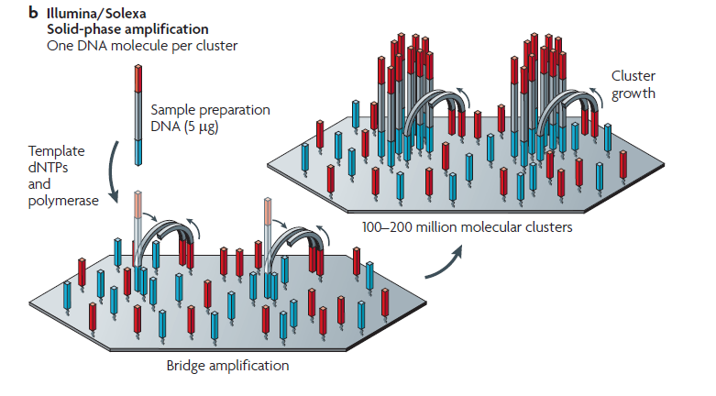
Making sequencing massively parallel
Solid Phase

Slide 18
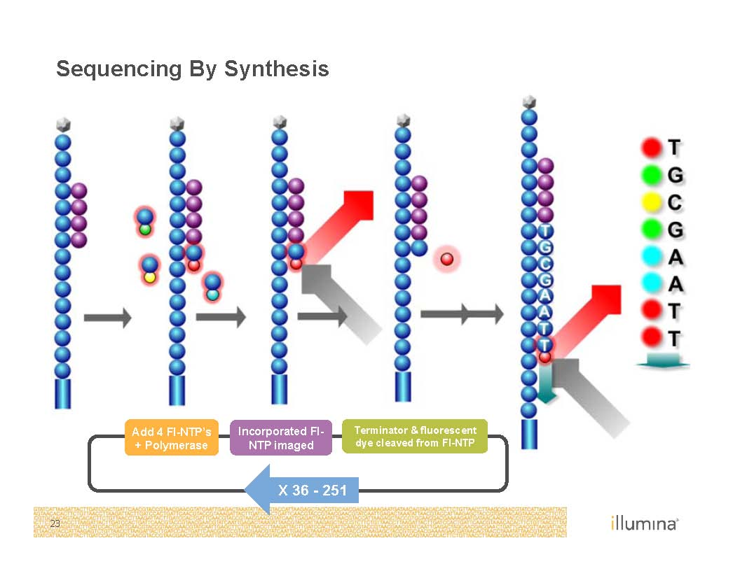

Slide 19
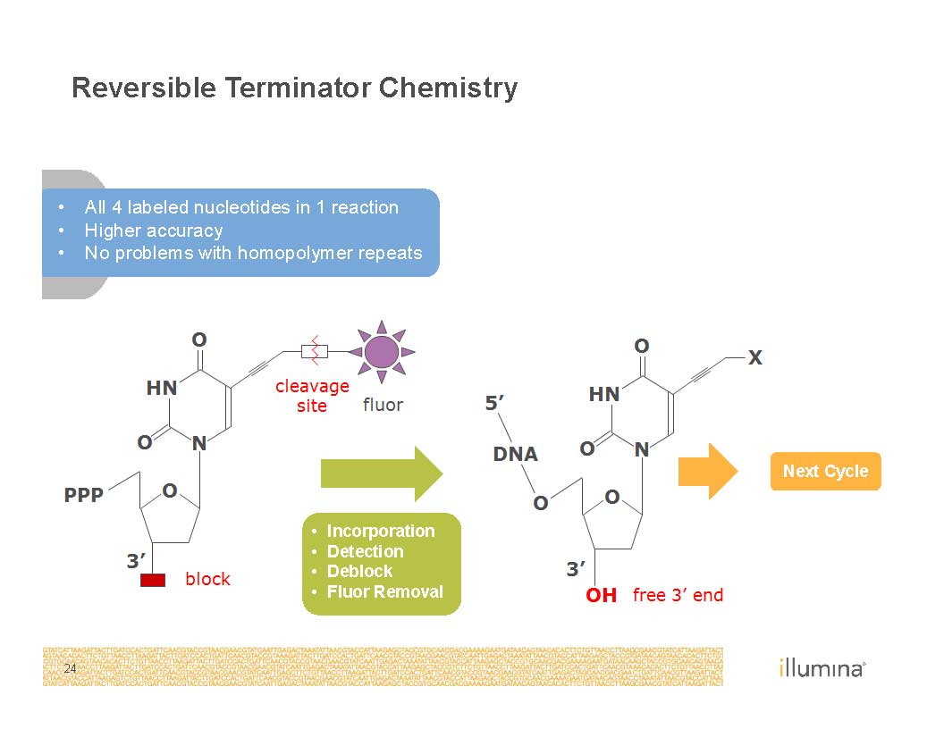

Slide 20
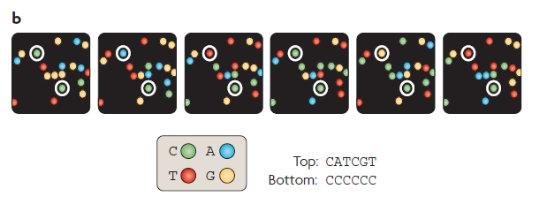
Illumina Stargazing

Slide 21
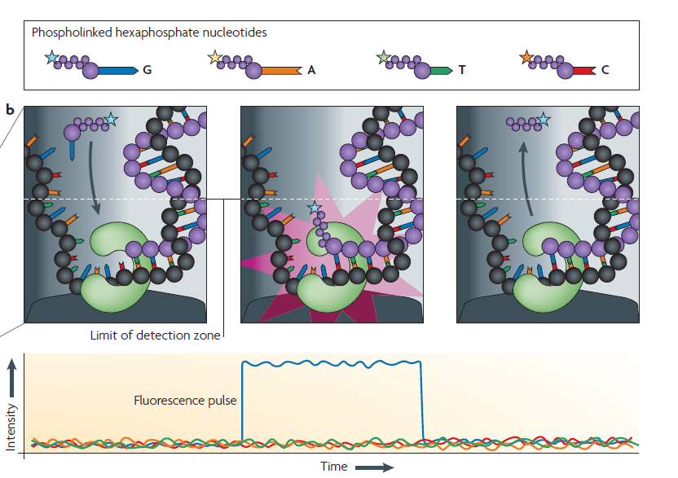
Pac Bio
Watch a Video showing the basics of the technology
https://www.youtube.com/watch?v=hBr0TJg-N6U

Slide 22
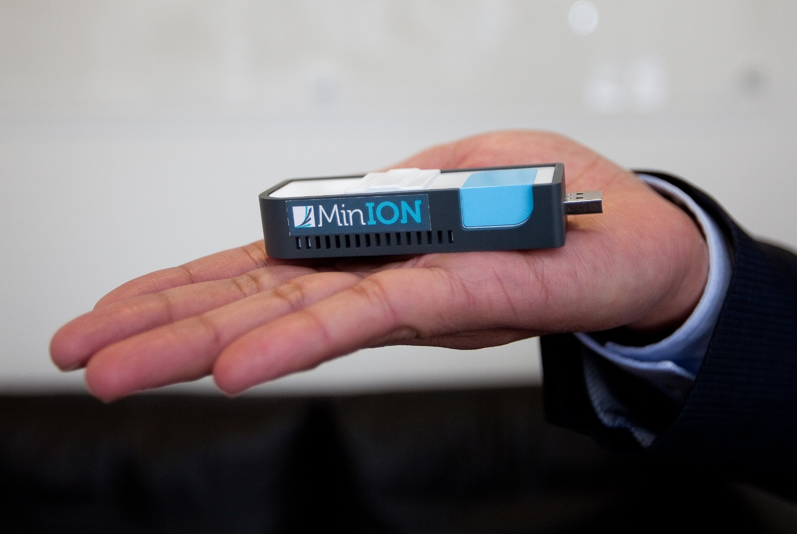
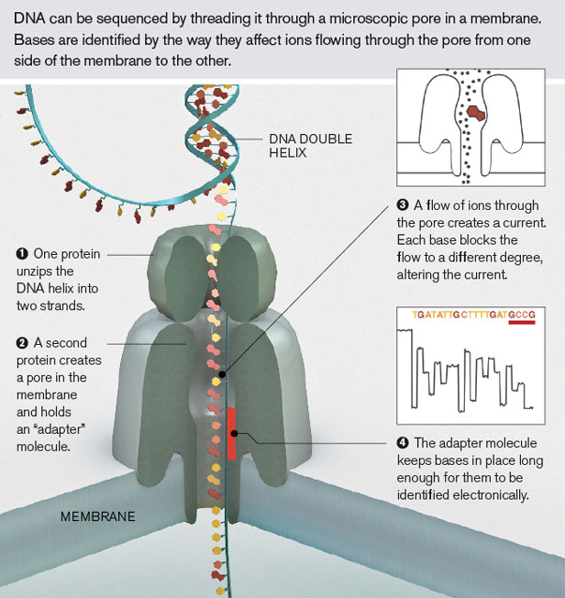
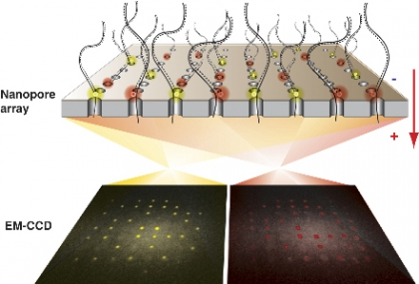
Nanopore Sequencing
https://www.youtube.com/watch?v=3UHw22hBpAk

Slide 23
Data structures and conventions
The interaction of computers and data requires that we follow strict conventions for how we communicate genomic data.
Bioinformatics relies on the use of common file formats.

Slide 24
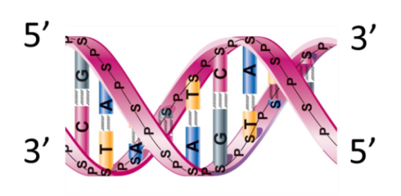
Some simple concepts about DNA sequence data
In bioinformatics, DNA or RNA is depicted in a single string from 5’ to 3’ and only one strand shown (saves space). Similarly, protein sequences are always written from the N-terminus to the C- terminus.
“It has not escaped our notice that the specific pairing we have postulated immediately suggests a possible copying mechanism for the genetic material.”
In J.D. Watson and F.H.C. Crick, 'A Structure for Deoxyribose Nucleic Acid,' Letter in Nature (25 Apr 1953)

Slide 25
The FASTA File Format
Protein FASTA
>gi|129295|sp|P01013|OVAX_CHICK GENE X PROTEIN (OVALBUMIN-RELATED)
QIKDLLVSSSTDLDTTLVLVNAIYFKGMWKTAFNAEDTREMPFHVTKQESKPVQMMCMNNSFNVATLPAE
KMKILELPFASGDLSMLVLLPDEVSDLERIEKTINFEKLTEWTNPNTMEKRRVKVYLPQMKIEEKYNLTS
VLMALGMTDLFIPSANLTGISSAESLKISQAVHGAFMELSEDGIEMAGSTGVIEDIKHSPESEQFRADHP
FLFLIKHNPTNTIVYFGRYWSP
Nucleotide FASTA
>SRR014849.1 EIXKN4201CFU84 length=93
GGGGGGGGGGGGGGGGCTTTTTTTGTTTGGAACCGAAAGG
GTTTTGAATTTCAAACCCTTTTCGGTTTCCAACCTTCCAA
AGCAATGCCAATA
Quality Files with PHRED quality scores are often created in parallel
>SRR014849.1 EIXKN4201CFU84 length=93
18 10 5 3 2 1 1 1 1 1 1 1 1 1 1 1 22 37 31 22 16 11 6 1 26 34 30 11 33 26 30 21
33 26 25 36 32 16 36 32 16 36 32 20 6 24 33 25 30 25 2 24 36 32 15 35 31 17
36 32 20 6 25 29 20 30 25 4 32 26 32 2332 26 30 24 33 26 35 31 14 28 27 30 22
28 24 27 17 32 23 28 28
Extension | Meaning
.fna | fasta nucleic acid
.ffn | FASTA nucleotide of gene regions
.fasta (.fas) | generic fasta
.faa | fasta amino acid
.fq (.fastq) | FASTQ file

Slide 26
Quality scores and meaning. Quality scores = -log₁₀(probability of error)
Phred Quality Score | Probability of incorrect base call | Base call accuracy
10 | 1 in 10 | 90 %
20 | 1 in 100 | 99 %
30 | 1 in 1000 | 99.9 %
40 | 1 in 10000 | 99.99 %
50 | 1 in 100000 | 99.999 %

Slide 27
FASTQ file format
The general format is similar in style to FASTA but has quality score attached in same file and given as ASCII characters to save space. This is the common format for raw sequence data.
@title and optional description
sequence line(s)
+optional repeat of title line
quality line(s)
@SRR014849.1 EIXKN4201CFU84 length=93
GGGGGGGGGGGGGGGGCTTTTTTTGTTTGGAACCGAAAGG
GTTTTGAATTTCAAACCCTTTTCGGTTTCCAACCTTCCAA
AGCAATGCCAATA
+SRR014849.1 EIXKN4201CFU84 length=93
3+&$#"""""""""""7F@71,’";C?,B;?6B;:EA1EA
1EA5’9B:?:#9EA0D@2EA5’:>5?:%A;A8A;?9B;D@
/=<?7=9<2A8==

Slide 28
Sequences are expected to be represented in the standard IUB/IUPAC amino acid and nucleic acid codes.
The nucleic acid codes are:
A adenosine C cytidine G guanine
T thymidine N A/G/C/T (any) U uridine
K G/T (keto) S G/C (strong) Y T/C (pyrimidine)
M A/C (amino) W A/T (weak) R G/A (purine)
B G/T/C D G/A/T H A/C/T
V G/C/A - gap of indeterminate length
The amino acid codes are:
A alanine P proline
B aspartate/asparagine Q glutamine
C cystine R arginine
D aspartate S serine
E glutamate T threonine
F phenylalanine U selenocysteine
G glycine V valine
H histidine W tryptophan
I isoleucine Y tyrosine
K lysine Z glutamate/glutamine
L leucine X any
M methionine * translation stop
N asparagine - gap of indeterminate length

Slide 29
GFF files describe the position of genes in a FASTA file.
Position | Name
1 | sequence
2 | source
3 | feature
4 | start
5 | end
6 | score
7 | strand
8 | frame
9 | attributes.
The general feature format
(gene-finding format, or
generic feature format, GFF)
is a file format used for describing
genes and other features of DNA,
RNA and protein sequences.
The filename extension is .GFF.
In a GFF file there are 9 columns
of information for each feature in
a DNA sequence (FASTA file).

Slide 30
Sequence Alignment Map (SAM) Files or BAM for binary version
11 mandatory fields in each row: separated by spaces in a text file
1=Read Name, 2=bitwise flag, 3=Reference Sequence, 4=start position of read in reference, 5= Map Quality, 6= CIGAR string, 7= paired end read reference, 8=position of mate, 9=distance between reads, 10=Read sequence, 11=read quality.
1:497:R:-272+13M17D24M 113 chr1 497 37 37M chr15 100338662 0
CGGGTCTGACCTGAGGAGAACTGTGCTCCGCCTTCAG
0;==-==9;>>>>>=>>>>>>>>>>>=>>>>>>>>>>

Slide 31

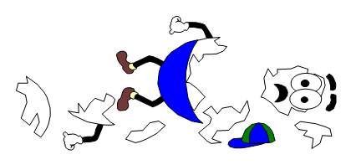
Sequencing and assembling a genome
The process of sequencing genomes typically involves breaking the genome up and then attempting to put Humpty-Dumpty back together again.

Slide 33
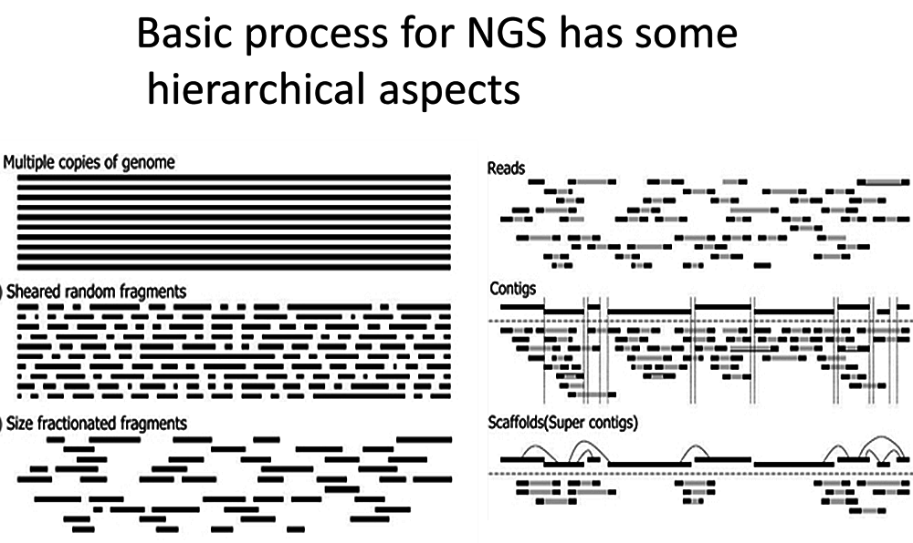
Sequencing a genome

Slide 34
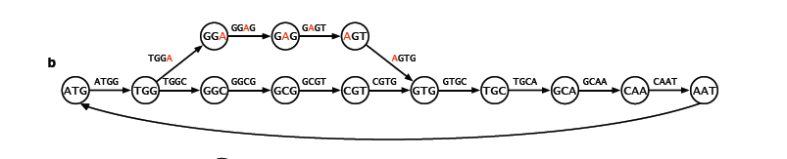
In real data, there will be sequencing errors and polymorphisms. In the figure below, a single base difference results in two paths that diverge and then converge. This could be caused by a sequencing error in the middle of a read or polymorphisms. If this represents heterozygosity, the paths may have equal representation.

Slide 35
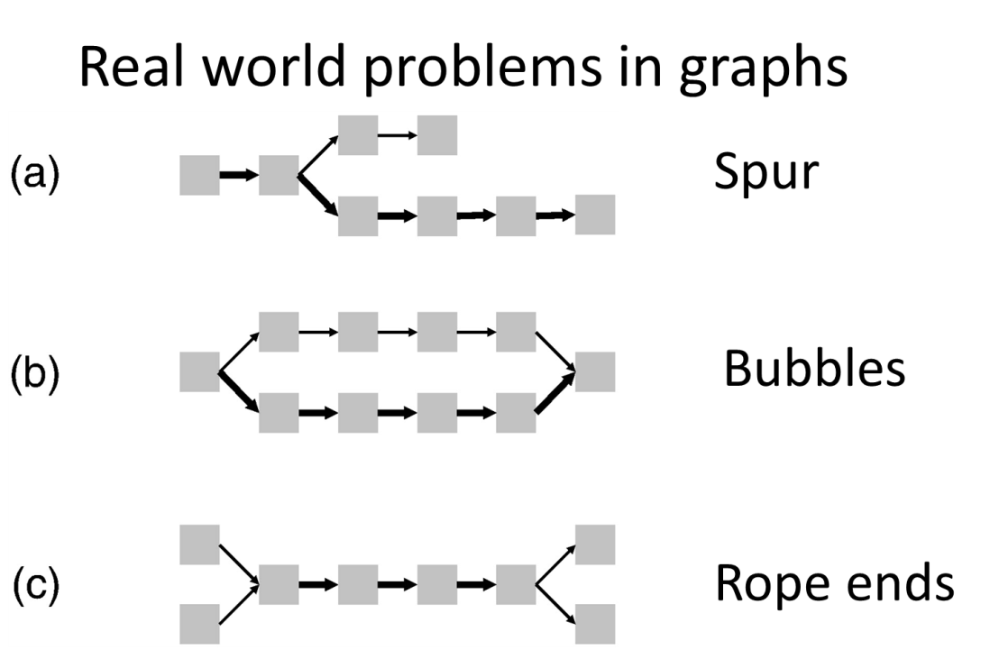
In the diagram below, the path complexities include spurs that will result from a sequencing error at the end of a read, bubbles as shown above and “rope ends”. Rope ends depict two different paths that share a common set of k-mers. These are the result of repeats that are greater than the length of a k-mer.

Slide 36
Assembly output and assessing the quality of an assembly:
De novo and assembly produces two main outputs.
Contig file (FASTA or multi FASTA)
SAM file: SAM (Sequence Alignment/Map) format is a generic format for storing large nucleotide sequence alignments.

Slide 37
How do we assess the quality of an assembly? There are three basic measures of assembly quality:
N50: A measure of average contig size. Specifically, ½ of the genome is assembled in contigs of this size or greater.
Depth of coverage: A measure of how much information is available for each base call.
Completeness of the gene catalogue: What percentage of the genes are assembled into contigs?

Slide 38
Key challenges for genome assembly:
Intrinsic Challenges:
Heterozygosity: The alleles of a gene are not the same, yet we typically force them into a single consensus sequence.
Paralogy vs. Alleleism: Genes come from other genes by a process of duplication. This results in two or more similar genes in an organism. There are two alleles in a diploid organism that are very similar. How do you tell a duplicated gene from alleles of a gene?
Sequence complexity: Simple sequence repeats (SSR), large-scale repeats like transposable elements (TEs).

Slide 39
Extrinsic Challenges:
Quality of DNA sequences (sequencing errors): Each sequencing technology has specific patterns of error. For example, pyrosequencing typically has high error rates associated with runs of a single nucleotide.
Length of DNA sequence reads: Shorter reads are less likely to be unique or to include many unique K-mers (see below).
Coverage: Depth of Coverage is a random process at best. Consequently some regions of the genome will have low levels of coverage.
Memory intensive: Inherently requires large amounts of RAM for assembly and storage for input and output.
Software: Need for approaches that are flexible, user friendly and powerful.

Slide 40
Genome annotation and inferring function
Once we have assembled a genome into one or more large “contigs” how do we “read” the DNA sequences and predict the genes and their functions

Slide 41
Inferring Function from a DNA Sequence
We use our understanding of cellular processes and evolution to predict the existence and function of genes in DNA sequences.
The near universal nature of the genetic code makes it possible to predict what protein sequences can be encoded by any DNA molecule.
Evolution allows us to compare genes and their proteins from one species to another.
When we have demonstrated the function of a gene in a model organism we often assume it will serve the same or similar role in other species

Slide 42
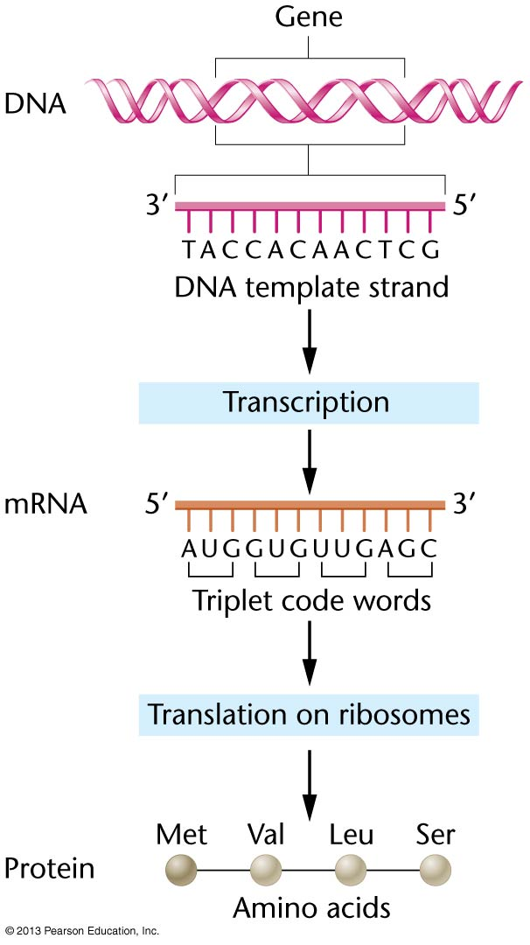
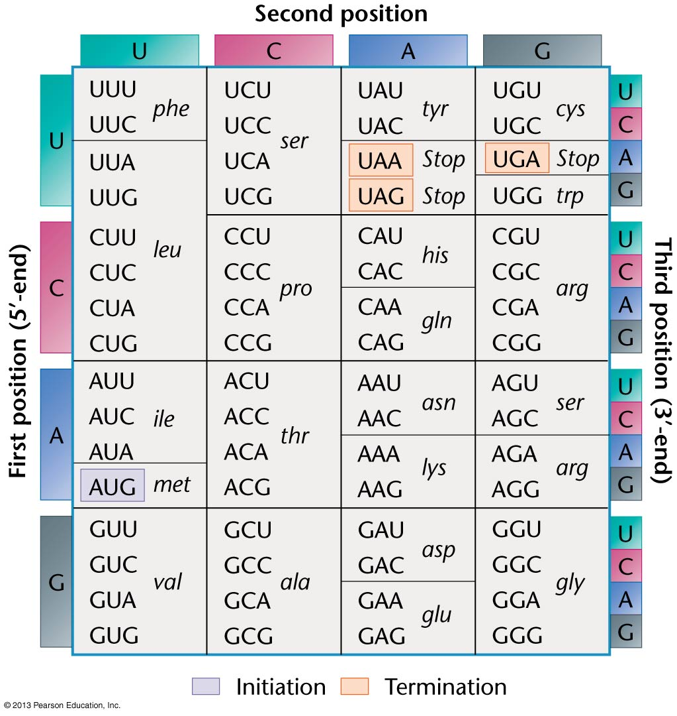
Most concepts in Bioinformatics rely on core knowledge of Genetics

Slide 43
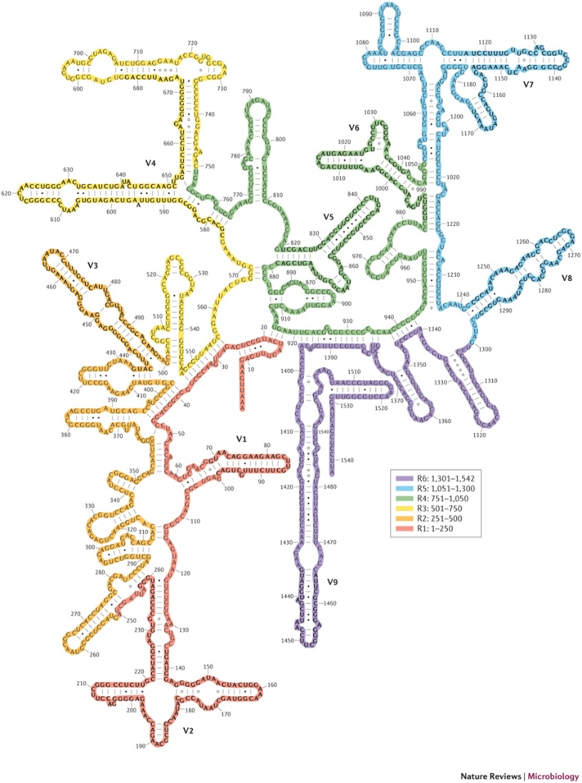
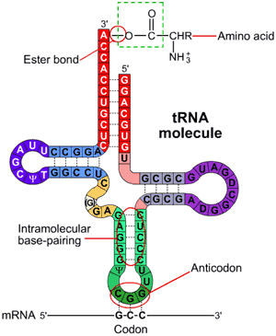
Beyond protein coding genes
Not all genes encode proteins
How would you find the genes for transfer RNAs and ribosomal RNAs in a DNA molecule?
You can look for similar sequences identified in related organisms
You can consider their special features like secondary structures

